Slide 1



抖音创作工具 Android 架构思考与实践
王鹏 Android GDE
Beijing

Slide 2
内容
业务特点及挑战
架构及其演进
防劣化能力

Slide 3

创作工具
帮助用户拍摄和发布短视频作品，并通过特效、贴纸等有趣功能激发创意表达。

Slide 4


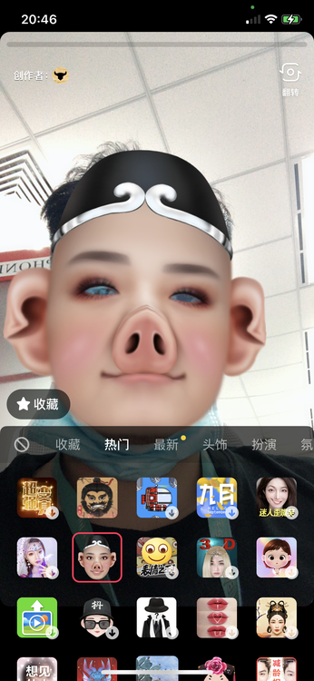
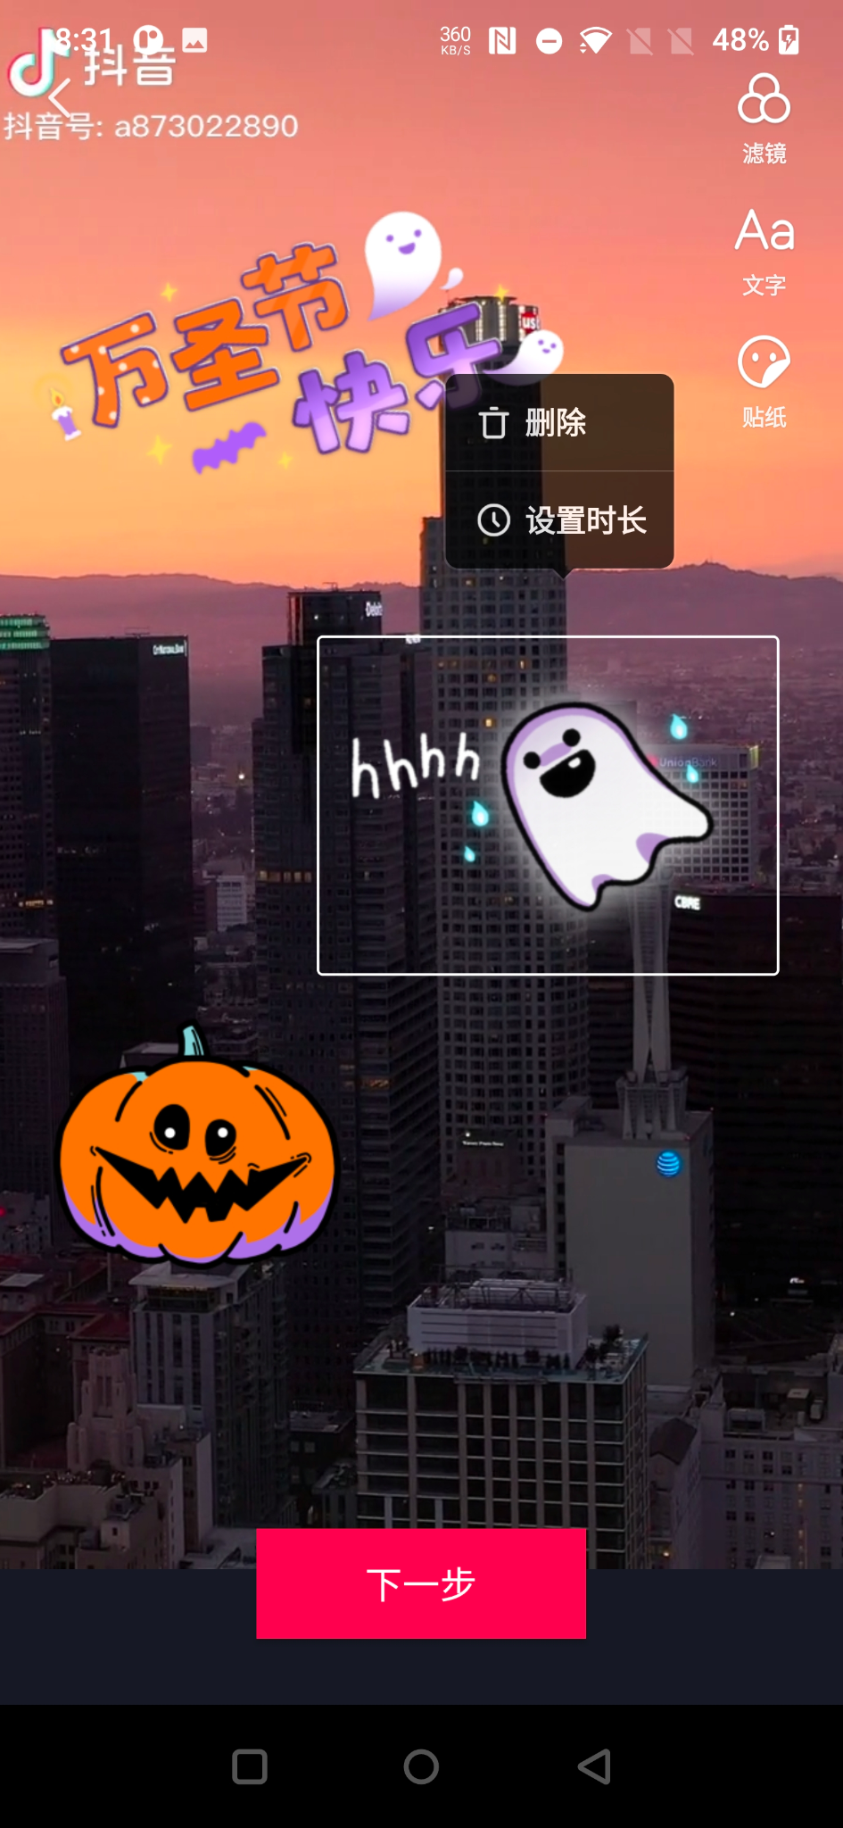
创作流程
滤镜
贴纸
美颜
文字
道具
特效
. . .
. . .
拍摄
编辑

Slide 5
业务挑战
页面功能复杂，手势、面板、控件...
ABTest驱动，功能替换频繁
性能敏感，首帧体验尤为关键

Slide 6
架构思考
页面组件化：快速搭建UI
关注点分离：UI&Logic解耦
按需加载：极致首帧体验
防劣化：及时发现架构问题

Slide 7
架构关键角色
Feature
Scene - UI单元
Component - Logic单元
Feature - 业务单元
Component
Scene

Slide 8
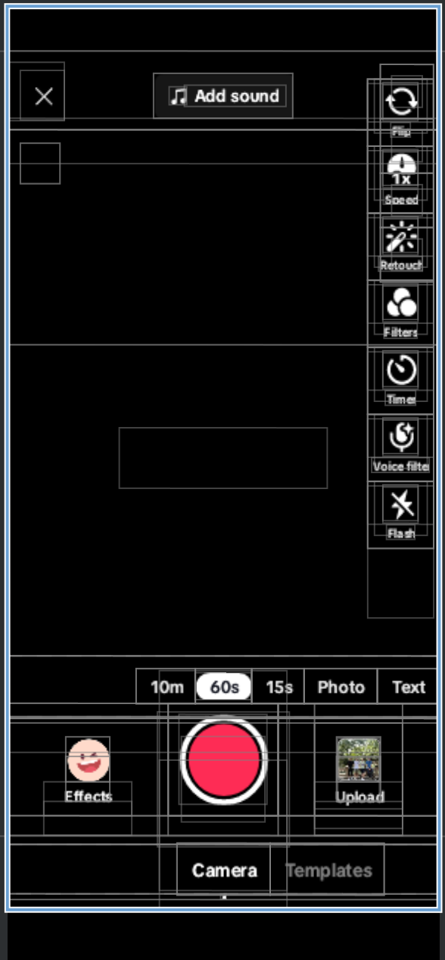
Scene
提供页面组合和导航，类比Fragment
规避Fragment的易用性问题
val childScene = ChildScene()
parentScene.add(R.id.container, childScene, "childScene")
parentScene.hide(childScene)
parentScene.show(childScene)
parentScene.remove(childScene)

Slide 9
Scene
Lifecycle
Scene
Activity
Fragment
onCreate
onCreateView
onViewCreated
onAttach
onCreate
onCreateView
onActivityCreated
onStart
onStart
onStart
onResume
进入前台
onResume
onResume
退出后台
onPause
onPause
onStop
onPause
onStop
onDestroyView
onStop
onDestroy
onDestroyView
onDestroy
onDetach
https://github.com/bytedance/scene

Slide 10
Scene 的问题
创建/组装/显隐控制造成父容器逻辑复杂
内部Logic&UI无法解耦

Slide 11
引入 Component
比Scene更长的生命周期
降低父容器负担
承载逻辑和状态
可按需加载

Slide 12
Component 创建 Scene
class FilterPanelComponent(private val parentScene: GroupScene) {
//The scene created and holded in this component
private val panel: Scene by lazy { ... }
fun show(visible: Boolean) {
if (!parentScene.contains(scene)) {
parentScene.add(R.id.scene_container, panel, "filterPanel")
}
if(visible) parentScene.show(panel)
else parentScene.hide(panel)
}
}

Slide 13
Component vs ViewModel
UI Layer
Fragment
Scene
has-a
Loigc Layer
has-a
ViewModel
Component

Slide 14
UDF 通信
UI
Layer
Scene
“ A unidirectional data flow (UDF) is a design pattern where state flows down and events flow up. By following unidirectional data flow, you can decouple composables that display state in the UI from the parts of your app that store and change state. ”
https://developer.android.com/jetpack/compose/architecture#udf
UIAction
UIState
Logic
Layer
Component
Domain
Layer
Domain Model

Slide 15
data class MySceneStates(
val name: String
)
data class MySceneActions(
val onButtonClicked: () -> Unit
)
class MyComponent(private val parentScene: GroupScene) :
UIComponent<MySceneStates, MySceneActions>() {
//构建 UI 初始状态
override val defaultStates = {
MySceneStates(
name = "default"
)
}
//响应 UI 事件
override val sceneActions = {
MySceneActions(
onButtonClicked = this::onButtonClicked,
)
}
}
private fun onButtonClicked() {
...
setState {
//this: MySceneStates
copy(name = "newValue")
}
}
https://github.com/airbnb/mavericks

Slide 16
class MyScene : UIScene<MySceneStates, MySceneActions>() {
private lateinit var textView: TextView
private lateinit var button: Button
override fun onActivityCreated(savedInstanceState: Bundle?) {
super.onActivityCreated(savedInstanceState)
//observe state change
uiStates.observe(MySceneStates::name) {
textView.text = it
}
button.setOnClickListener {
uiActions.onButtonClicked()
}
//read state value
val name = uiStates.value.name
}
}

Slide 17
DSL 组装 Component
class ComponentActivity : AppCompatActivity() {
override fun onCreate(savedInstanceState: Bundle?) {
super.onCreate(savedInstanceState)
components {
//registe components using DSL
component { ToolbarComponent(...) }
component { FilterPanelComponent(...) }
component { BeautyPanelComponent(...) }
...
}
}
}

Slide 18
Component 按需加载
Loaded
Unloaded
Comp
Comp
Comp
Comp
Comp
Comp
invoke
invoke
Comp
Comp
Comp
Comp
Comp
Comp
Comp
Comp
Comp
Comp
Comp
Comp
首屏加载
按需加载

Slide 19
Component 按需加载
components {
component { ToolbarComponent(...) }
component(AttachOption.LAZY) { FilterPanelComponent(...) } //按需加载
component(AttachOption.LAZY) { BeautyPanelComponent(...) } //按需加载
...
}
class ToolbarComponent() {
private val FilterPanelComponent: FilterPanelComponent by inject()
fun showFilterPanel() {
FilterPanelComponent.showPanel()
}
}

Slide 20
Component 服务发现
@ComponentDsl
inline fun <reified T> component(
attachOption: AttachOption = AttachOption.IMMEDIATE
crossinline init: (ComponentBuilder).(ObjectContainer) -> T
): ComponentBuilder
key
value
CompA::class
CompAProvider
CompB::class
CompBProvider
。...
...
inline fun <reified T> ObjectContainer.inject(): Lazy<T> =
lazy(LazyThreadSafetyMode.NONE) {
val compProvider = this.getProvider<T>(T::class.java)
compProvider.get()
}
ObjectContainer
https://insert-koin.io/

Slide 21
Component 的问题
"the dependency graph of packages or components should have no cycles" - 《Clean Architecture》
CompA
CompA
CompA
CompB
CompB
CompB
CompC
CompC
CompC

Slide 22
Feature
FilterFeature
BeautyFeature
UI
Layer
FilterPane
Scene
FilterSwipe
Scene
BeautyPanel
Scene
Component集合
高内聚、低耦合
单向依赖
垂直分层
action
state
action
state
action
state
FilterPanel
Componet
FilterSwipe
Componet
BeautyPanel
Componet
Logic
Layer
FilterLogic
Component
BeautyLogic
Component
Domain
Layer
FilterModel
BeautyModel

Slide 23
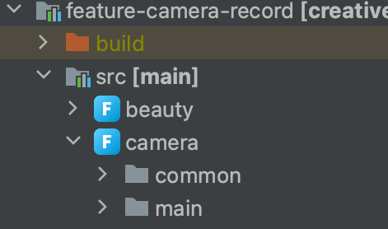
Feature Module
src
├── beauty
│ ├── open #外部可访问
│ │ └── BeautyLogicComp
│ └── panel
│ ├── BeautyPanelScene
│ ├── BeautyPanelUiState
│ └── BeautyPanelComp
│
├── filter
│ ├── panel
│ │ ├── FilterPanelScene
│ │ ├── FilterPanelUiState
│ │ └── FilterPanelComp
│ ├── swpie
│ │ ├── FilterSwipeScene
│ │ ├── FilterSwipeUiState
│ │ └── FilterSwipeComp
│ └── logic
│ └── FilterLogicComp
│
├── camera
│ ├── open
│ │ └── CameraComponent
│ └── ...
│
├── ...
SourceSet组织目录
IDE-Plugin截断代码联想以及代码/资源隔离飘红
Gradle配置依赖关系
IDE 呈现

Slide 24
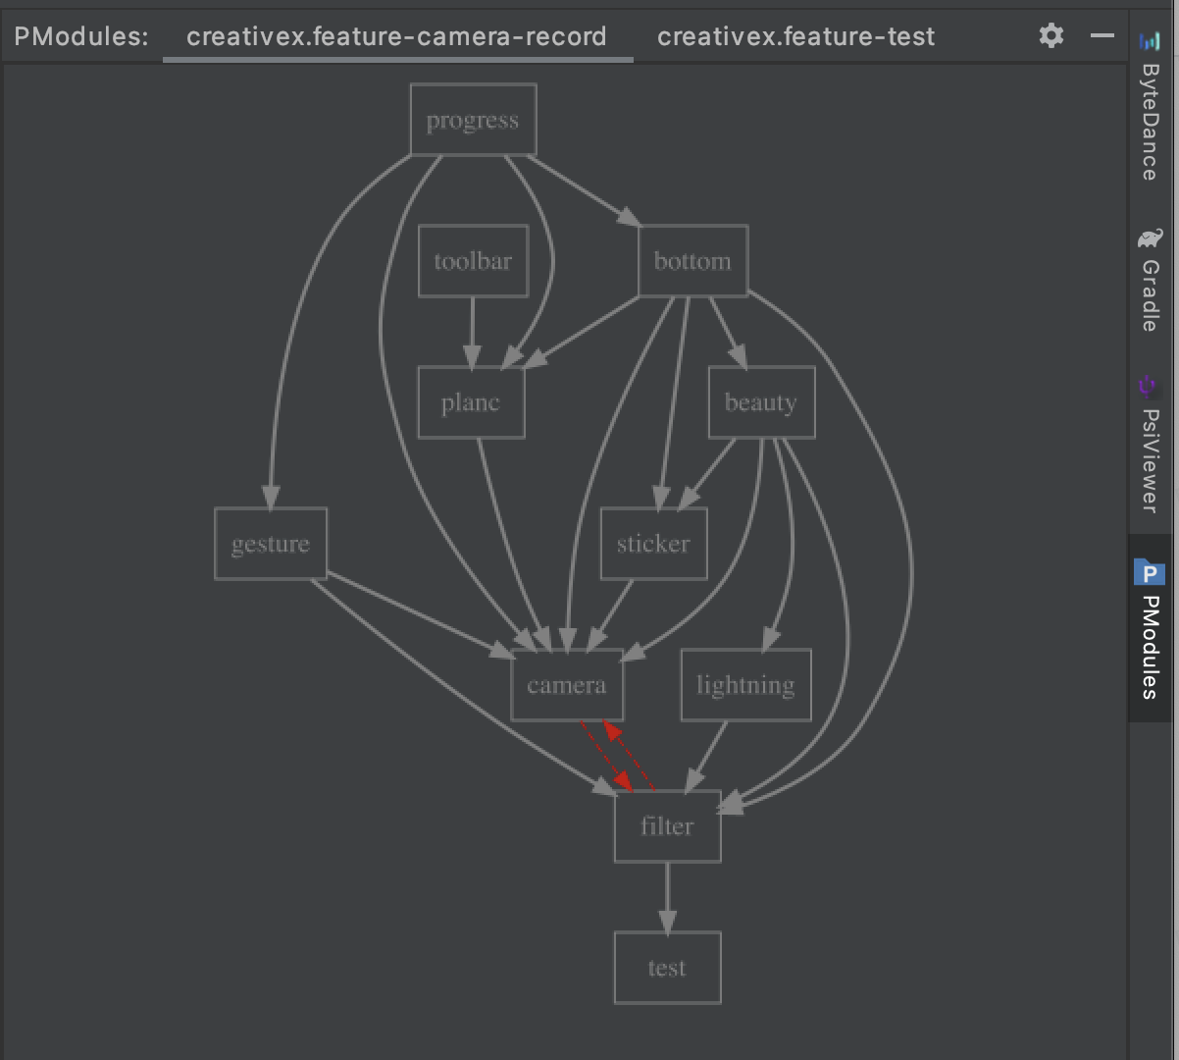
features.gradle
featureModules {
filter {
path "com.douyin.tools.filter"
dependsOn "camera", "beauty"
}
camera {
path "com.douyin.tools.camera"
dependsOn "filter"
}
beauty {
path "com.douyin.tools.beauty"
dependsOn "camera", "sticker"
}
sticker {
path "com.douyin.tools.sticker"
dependsOn "camera"
}
}
依赖关系可视化

Slide 25
Component 服务发现的问题
Component构造成本高
依赖缺失造成运行时异常
components {
component { ToolbarComponent(...) }
component(AttachOption.LAZY) { FilterPanelComponent(...) }
component(AttachOption.LAZY) { BeautyPanelComponent(...) }
...
}

Slide 26
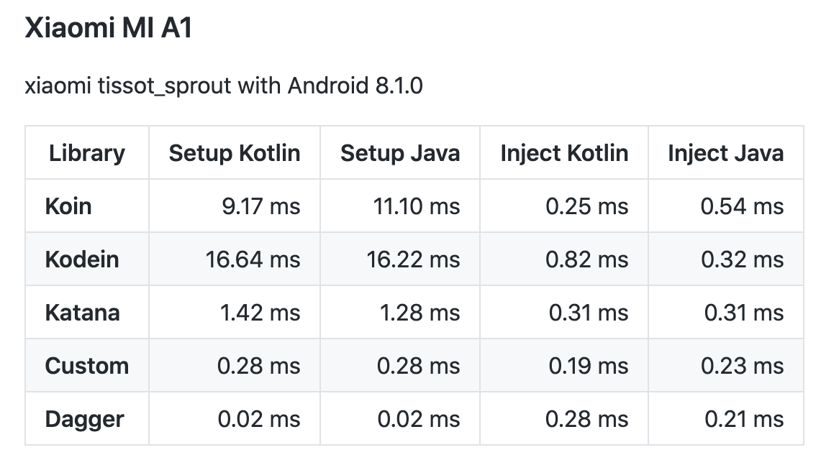
Dagger over Koin
效率：降低容器复杂度
质量：编译期发现问题
性能：降低启动开销

Slide 27
引入 DI
components {
component(R.id.xxx, CameraComponent::class)
component(AttachOption.LAZY, R.id.xxx, FilterPanelComponent::class)
component(AttachOption.LAZY, R,id,xxx, BeautyPanelComponent::class)
...
}
@Component //generate inject code
class FilterLogicComponent @Inject constructor() {
@Inject lateinit var filterModel: FilterModel
val beautyLogicComponent: BeautyLogicComponent by inject()
fun onCreate() {
filterModel.doSth() // crash by invalid invoke
}
}

Slide 28
自定义 Scope
@Singleton
@Singleton
SingletonComponent
Singleton
Component
通过自定义 Scope，提供更精细的访问控制
@SceneScoped
@ActivityScoped
SceneComponent
ActivityComponent
@SubSceneScoped
SubScene
Component
@SubSceneScoped
@FragmentScoped
SubScene
Component
@SubSceneScoped
FragmentComponent
SubScene
Component
...

Slide 29
自定义 Scope
@DefineContainer
annotation class RootContainer
@DefineContainer(parent = RootContainer::class) // build scope relationship
class FilterContainer
@Container(FilterContainer::class)
class FilterScene : GroupScene() { ... }
@Component(container = FilterContainer::class) //generate inject code
class FilterLogicComponent { ... }
@Module
@InstallIn(FilterContainer::class) //provide module to container
interface FilterModule { ... }

Slide 30
防劣化能力
编码阶段
编译阶段
代码评审
集成阶段
配置组件
配置依赖
添加注解
修改飘红
修改编译错误
修改劣化
修改劣化
Comp
DSL
featurs
gradle
@Inject
Src
代码飘红
Obj DAG
Module DAG
架构劣化
非法访问
IDE Plugin
Hilt Processor
Transformer
CR
Linter
CI

Slide 31
总结
从现状出发，参考 MAD、Mrvx、Koin、Hilt 等优秀开源项目，摸索出了适合创作工具业务的最佳实践：
Scene - 拆分页面 UI
Component - 功能配置、承载逻辑
Featue - 实现业务模块的合理依赖
DI - 实现组件通信和依赖构建

Slide 32

Thank You！
加V交流
Beijing

